Slide 1


Slide 2




about me
Aman Yadav
Unity Student Ambassador
Chair @ACM Chandigarh University
linkedin.com/in/amankumaryadav/
learningt2cod3
amanyadav16
@t.me/currentaffairs2015

Slide 3
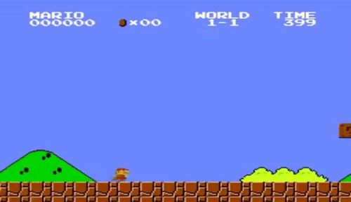
First Game?

Slide 4


Slide 5
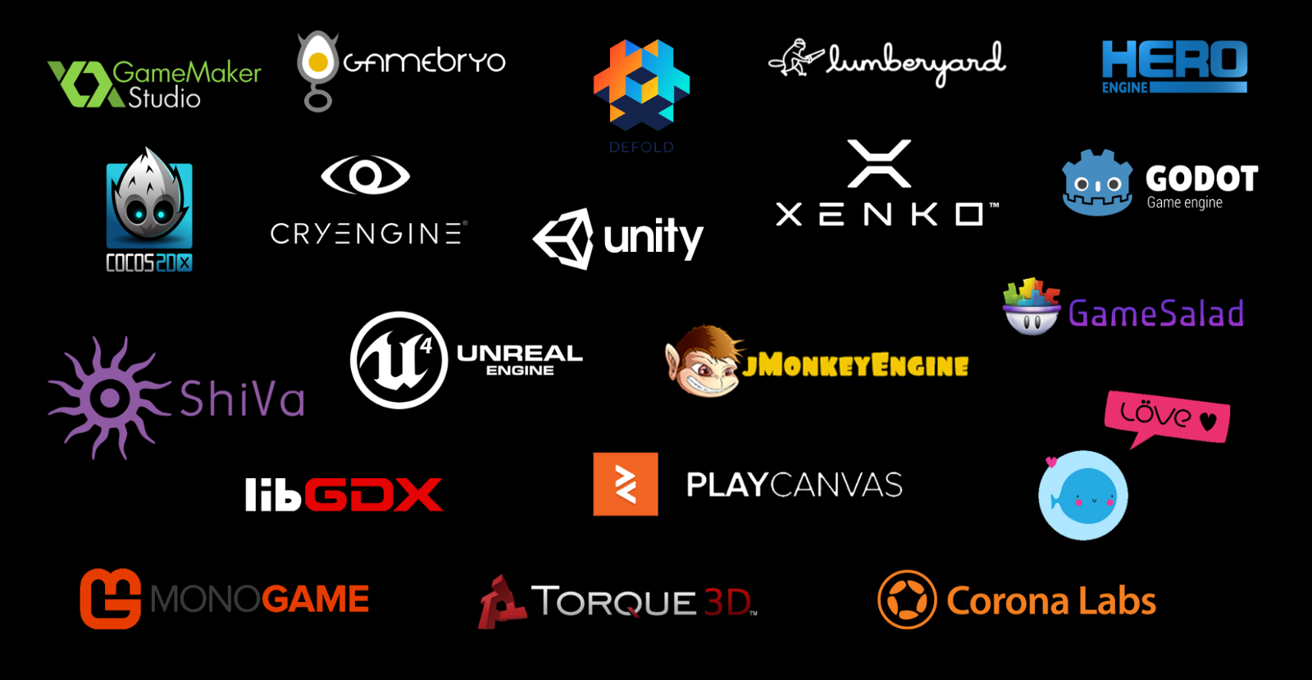

Slide 6
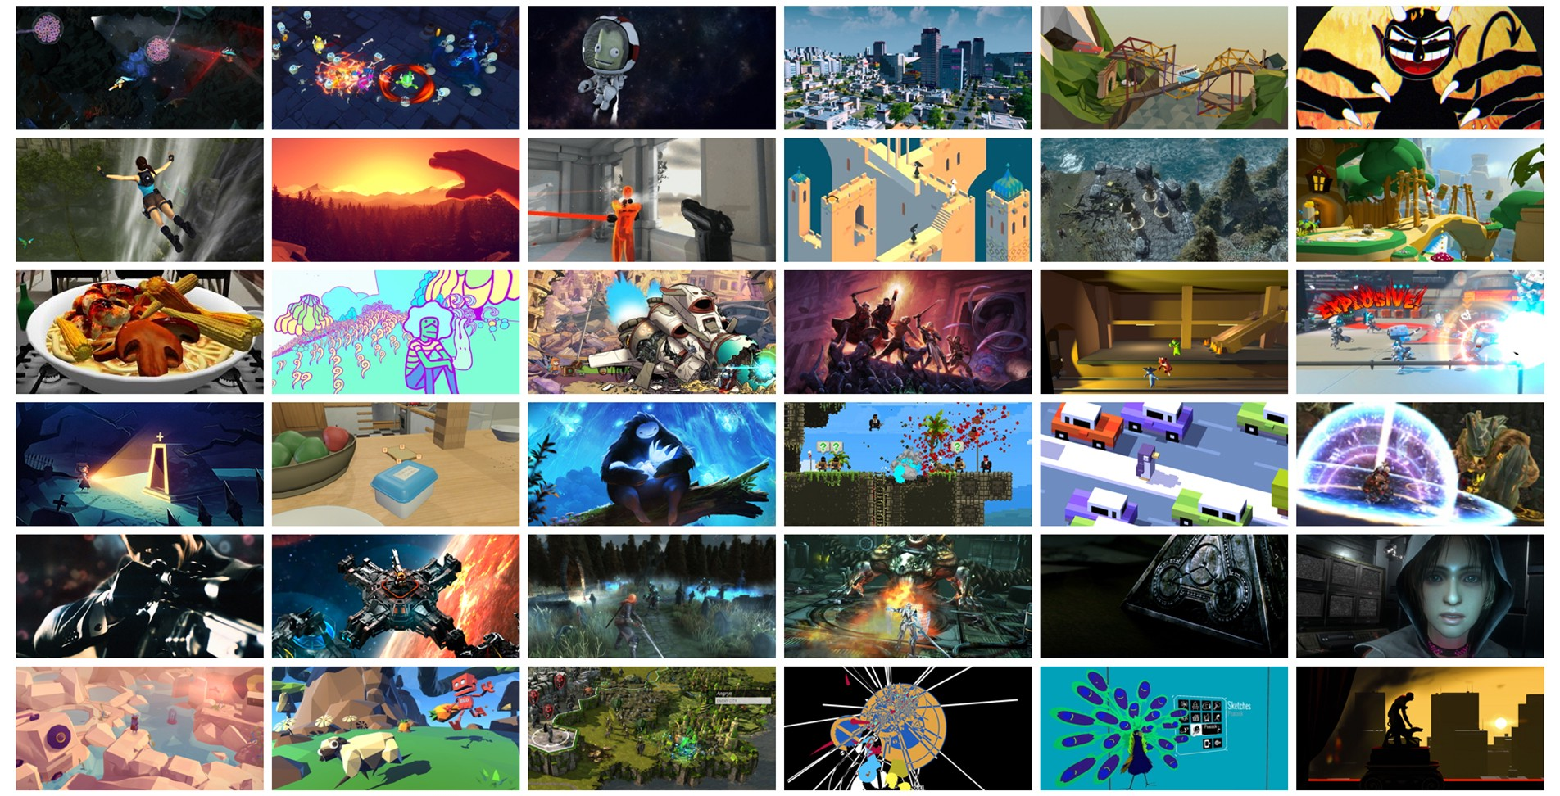
Create Experiences!

Slide 7
Why Unity?

Slide 8
“World is a better place with more creators in it”

Slide 9
World’s most widely used Realtime 3D platform

Slide 10
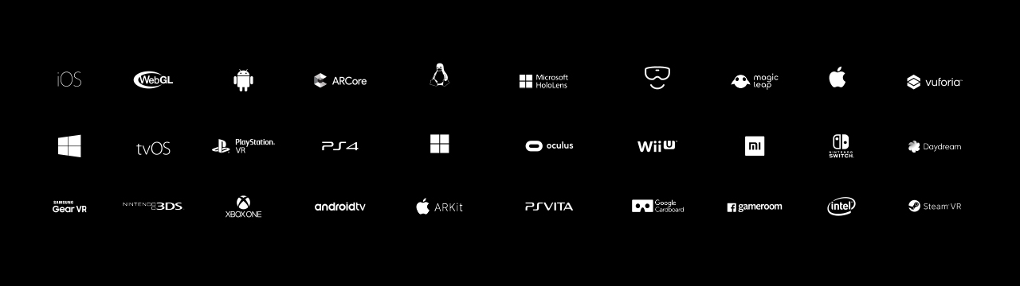
Build Once,
Deploy Anywhere!

Slide 11

Free. All-in-one editor for 2D & 3D games
Features. Allows to create, design and collaborate
Easy to Learn.
Friendly UI, Lots of Tutorials!

Slide 12
Powering over two-thirds of VR and AR experiences.

Slide 13
Cloud-Enabled Multiplayer
Server Hosting from Multiplay which powers millions of games online,
including 30 million chicken dinners
Vivox is trusted by the industry’s leading titles to deliver comms service
PUBG | League Of Legends | Rainbow Six Siege | Fortnite
Notes:
AI we have deepmind and tensorflow
Big Data we do Visualization and Specialized training for Hadoop etc with Unity3d
Cloud we use for Cloud Build Sync Storage and Version Control

Slide 14

The simplest way to increase revenue
Unity offers built-in solutions to
maximize your success
LTV Optimization | Ads | In-App Purchases

Slide 15
Enough, of the talks!
Notes:
kch

Slide 16


Slide 17
Questions?

